Slide 1

FLOOD FORECASTING
Presented by Gabriel Santiago B.

Slide 2
agenda
Introduction
Data
Model
Conclusion

Slide 3
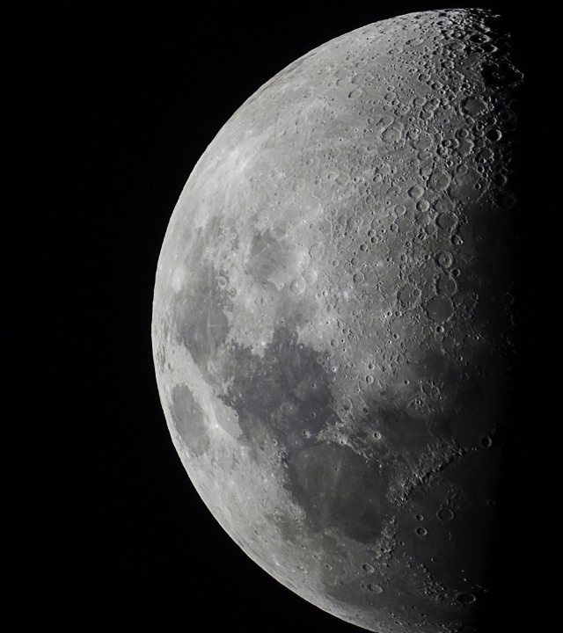
Introduction

Slide 4
PrOBLEMATIC
-1.5% PIB
+245k affected families
Peru is an Emerging Market Economy with sustained economic growth. However, as many Latin-American countries, it has not been unrelated to climate change.

Slide 5

DATA

Slide 6
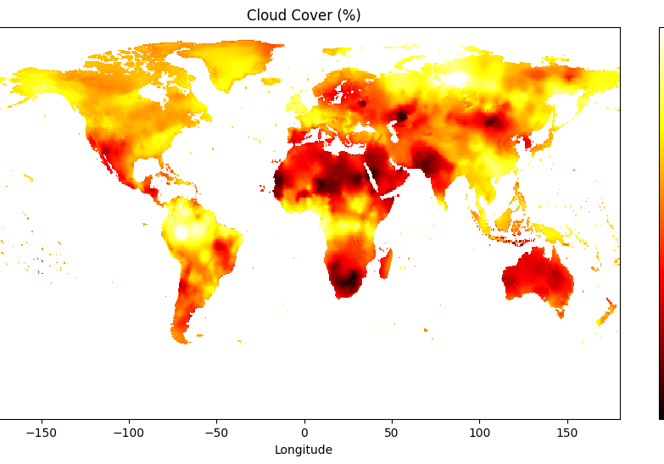
DATA SOURCES
Gridded Time Series Dataset
Set of month, latitude and longitude information of:
Cloud Coverage (%)
Temperature Range
Frost Days
Potential evapo-transpiration
Precipitation rate
Minimum temperature
Maximum temperature
Mean temperature
Vapour pressure
Wet days

Slide 7
DATA PROCESSING
…

Slide 8

Budget allocation
By focusing our financial resources on high-impact areas like technology and talent acquisition, we aim to drive innovation and enhance our competitive edge.

Slide 9
Quote
Smart financial decisions today drive lasting success for the future.

Slide 10
Budget allocation & growth forecast
Category | Budget allocation | Projected growth | ROI expectation
R&D investment | $75M | +20% annually | High
Marketing | $50M | +15% annually | Moderate
Operations | $40M | +5% annually | Stable
Tech upgrades | $30M | +25% annually | High
Market expansion | $80M | +30% annually | High
Cash reserves | $25M | N/A | Essential

Slide 11
Andrew Carnegie
“The first one gets the oyster, the second gets the shell.”

Slide 12
Strategies for sustainable growth
High-return opportunities
Targeted investments support long-term expansion. By focusing on high-return opportunities, we can maximize our growth potential and achieve sustainable success. Technology integration
Leveraging AI and automation to drive financial efficiency. By integrating advanced technologies into our operations, we can streamline processes, reduce costs, and enhance productivity. Market expansion
Entering new territories to maximize profitability. Expanding into new markets allows us to diversify our revenue streams and reduce our reliance on existing markets. Risk management
We implement strategies to hedge against financial uncertainties. By proactively managing risks, we can safeguard our business against potential threats and ensure long-term stability.

Slide 13

Moving forward with confidence
Financial stability
We remain committed to strong financial management.
Strategic investments
Our next steps focus on long-term value creation.
Sustained growth
We’re positioned for scalable expansion in the coming years.

Slide 14

Thank you
Presented by Frey Munch

